Slide 1

Mindreading & Joint Action
Mindreading & Joint Action
4. ***
butterfillS@ceu.hu
butterfillS@ceu.hu
Notes:
Last week I explained the overall project. This week I want to dive straight into a specific topic. I’ll link it back to the overall project at the end.

Slide 2
1. There are subjects who can pass A-tasks but cannot pass B-tasks.
2. These subjects’ success on A-tasks is explained by the fact that they can represent (false) beliefs
3. These subjects’ failure on B-tasks is explained by the fact that they cannot represent (false) beliefs
Notes:
Recall this puzzle from Lecture 1

Slide 3
— Neil Berthier, De Blois, et al. (2000: 395)

Slide 4
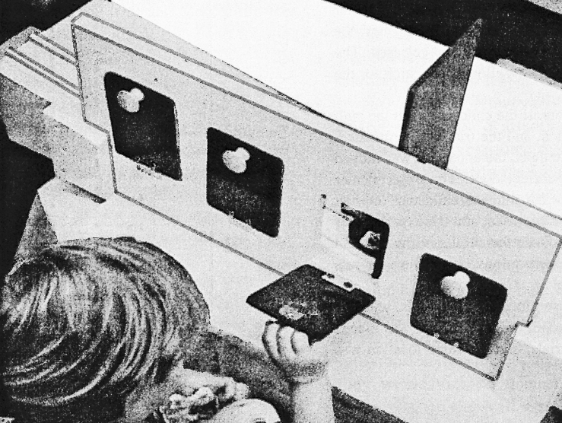
— Neil Berthier, De Blois, et al. (2000: 395)

Slide 5
— Neil Berthier, De Blois, et al. (2000: 395)

Slide 6
— Neil Berthier, De Blois, et al. (2000: 395)
Notes:
One common error pattern among older children – look behind door next to barrier but on wrong side of it

Slide 7
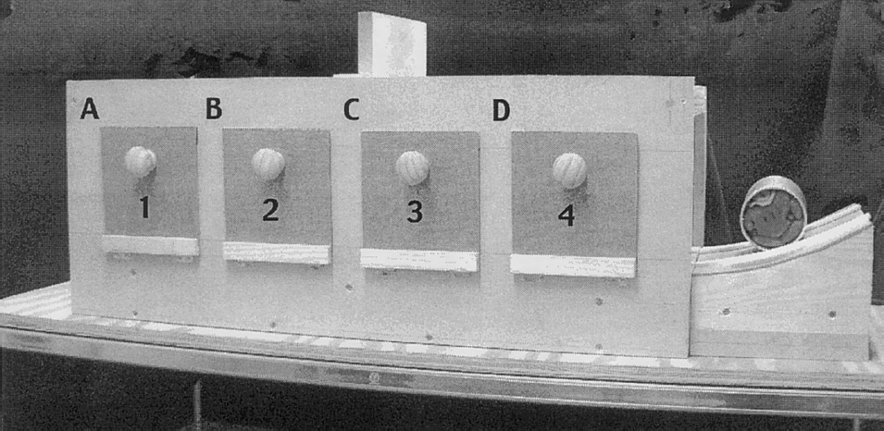
(Hood et al, 2003)
Notes:
2.5-year-olds look longer when experimenter removes the ball from behind the wrong door, but don't reach to the correct door

Slide 8
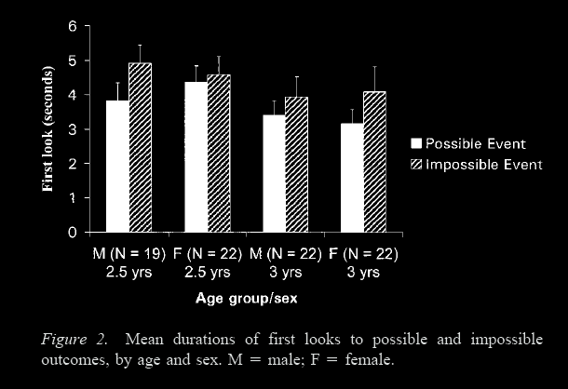
Looking time reveals causal understanding and 2.5- and 3-year olds
-- Hood et al (2003: 65)
(Hood et al, 2003)
Notes:
2.5-year-olds look longer when experimenter removes the ball from behind the wrong door, but don't reach to the correct door
Although the most studied case is false belief, this discrepancy between measures is very common. It occurs for tests involving physical reasoning, number, and speech; and probably also involving agency and space.

Slide 9
1. There are subjects who can pass A-tasks but cannot pass B-tasks.
2. These subjects’ success on A-tasks is explained by the fact that they can represent (false) beliefs
3. These subjects’ failure on B-tasks is explained by the fact that they cannot represent (false) beliefs
in a modular process
in a non-modular process
Notes:
The first step, then, is to distinguish two systems for representing beliefs, just as we have to distinguish multiple systems for representing causation, number, speech, space and the rest.
The distinction is between modular mindrreading and nonmodular mindreading.
But this distinction, although formally it removes the contradiction, raises a hard question.
How could belief ascription be modular?
On the face of it, anything you know, anything at all, can be relevant to a belief ascription. So representing and ascribing beliefs looks to be a paradigm case of the sort of thing that cannot be modular.
So we need to do more work to make this proposal plausible, to make it more than a merely formal move.

